Slide 1
FRC Programming Workshop
Bechtel Group 2016

Slide 2
Overview of the Workshop
Part I: Welcome and Introduction
  Introduction, Safety Message, Current Status Survey
Part II: Programming Projects
  Top Level Design, Detailed Implementation, Examples
Part III: Bugs and Troubleshooting
  Addressing Issues and Integration
Part IV: Programming Team Expectations
  Project Plan and Best Practices

Slide 3
PART I: Welcome & Introduction
Sign In and Introduction
Safety Message: What’s Your Safety Program
Overview of Java/C++ and LabView
Programming Challenge Part I

Slide 4
Safety Message: What’s Your Safety Program
http://www.firstinspires.org/sites/default/files/uploads/resource_library/frc/team-resources/safety/2015/frc-team-safety-manual.pdf
For your protection -> Power and Hand Tools
At Events -> not your typical place (Safety Captais Mtg)
Got the expected stuff?
http://www.techfire225.com/uploads/6/3/7/1/6371896/first_team_225_safety_manual_final.pdf
https://quizlet.com/15458037/flashcards

Slide 5
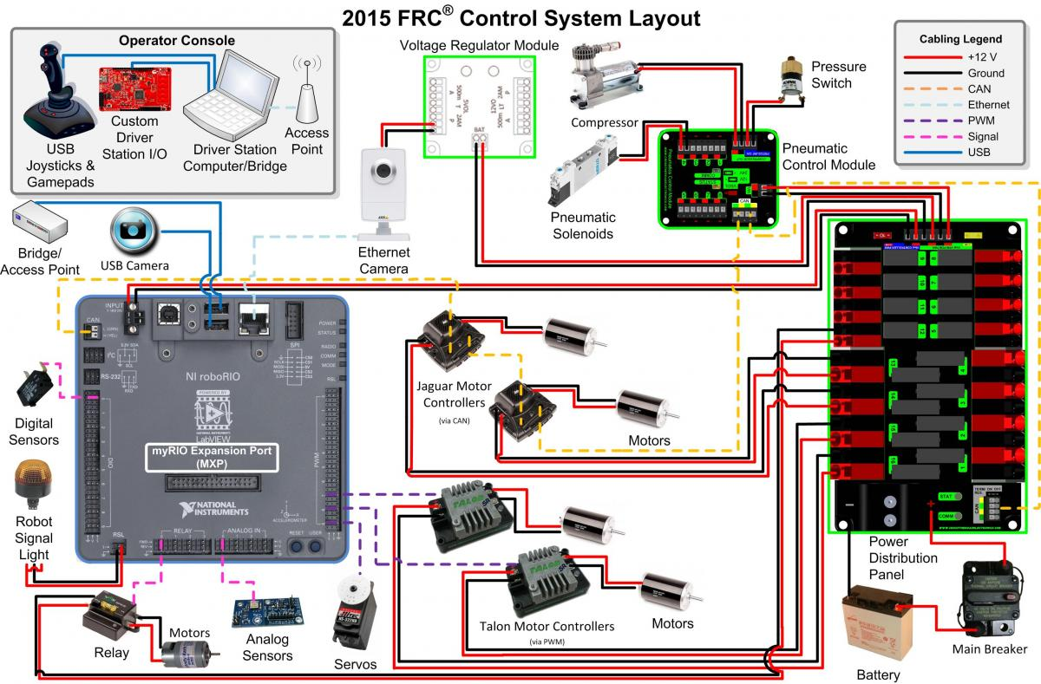
Hardware layout of the RoboRio

Slide 6
So What’s the Difference?
LabVIEW is an ISA S88 Batch Programming Language
  Batch Type Programs Take the Robot to a specific state.
  The LabVIEW Programming Instructions take the Robot from one state to the other
  However it does not document the State Table and the programmer needs to generate that documentation and maintain it.
Java and C++ is a procedural type language (like Basic, Fortran, Java)
  Procedure Language executes a series of comments in order.
  Main () is used as the starting point and Subroutine/Functions can be used to splite the program up in manageable sections of software – typically for a specific task
  However program flow is not documentated and Flow Charts are often used to document the program flow.
Summary – LabVIEW is used in Labs and Industry for Data Collection and interaction with the real world and C++ is used in more mainstream programming applications in many different types of applications.

Slide 7
PART II: Programming Projects
Top Level Program Design
The use of State Diagrams and PseudoCode (or Flow Chart)
Design of the Subroutines or Block Diagram
Data Dictionary
Programming Challenge I

Slide 8
Top Level Conceptualization
The Engineering Process
  Analyze the Problem
  Figure out the Constraints
  Generate Ideas
  Design the Project
Possible Approaches
  State Diagrams
  PseudoCode
  MindMaps
  Fishbones
  MetaStorming
  Concept Sketches

Slide 9
Top Level Conceptualization
Possible Approaches
  State Diagrams
  PseudoCode
  MindMaps
  Fishbones
  MetaStorming
  Concept Sketches

Slide 10
Top Level Conceptualization
https://forums.xilinx.com/t5/Xcell-Daily-Blog/Zynq-based-NI-roboRIO-ships-to-FIRST-Robotics-Competition-teams/ba-p/562233
Possible Approaches
  State Diagrams
  PseudoCode
  MindMaps
  Fishbones
  MetaStorming
  Concept Sketches

Slide 11
PART III: Best Programming & Debugging
Review Code Examples and Best Practices
Debugging approaches with LabVIEW
Debugging approaches with Java/C++

Slide 12
LabView Recommendations:
Lifted from Wiki LabVIEW
Call library function: Specify a path to the library with a constant Use the "Specify path on diagram" to determine if you can input the Library name or path on the block diagram. When you place a checkmark in this checkbox, path in and path out appear as input and output terminals on the connector pane for the node. When you place a checkmark in the checkbox, any library referenced in the Library name or path control will not be used. Note: You can use the path in input to unload a previously referenced library from memory. Wire an empty or invalid path to the path in input to unload any library previously referenced by the node from memory.
Formula node: Add comments to the text in a Formula Node by enclosing them inside a slash-asterisk pair (/*comment*/), or after a double-slash (//comment). Short scripts work well with the Formula Node because the Formula Node executes faster than the Math Script Node.
LabVIEW Classes: You can create a directory on disk named the same as the LabVIEW class to save the class library file, class member VIs, and class custom default probes. You can include the files that the class library owns in the directory. If you include files for more than one class library in the same directory, conflicts might occur if you try to include VIs of the same name in different class libraries. Naming conflicts can occur in the development process when you override dynamic member VIs.
Template Vis: You can add templates as subVIs to a template VI. To add a template as a subVI, open the VI template and drag the VI icon in the upper right corner of the front panel or block diagram window to the block diagram of the top-level template VI. When you create a VI from a template that contains template subVIs and save the VI, LabVIEW prompts you to save each template subVI as a VI.
Navigating controls and constants: To increment or decrement a numeric control or constant, use the Labeling tool to place the cursor in the control and press the up or down arrow keys. To increment or decrement numeric controls faster, use the Operating or Labeling tools to place the cursor in the control and press the <Shift> key while clicking the increment or decrement buttons. ##For arrays ##While executing a VI: If you right click on an Array Index Display of a control, indicator or probe, you can select 'Show Last Element' to go to the last element of the array. ##In development mode: If you want to look at the last element of an array control or indicator, right click on the Index Display and select Advanced-->Show Last Element (there is no 'Advanced' menu for probes so it always works by just right clicking).
Graphs: You can use an annotation instead of a cursor to highlight data points on the plot area. ##To increase the point size of data symbols on graphs and charts, increase the line width of the plot. Error handling ##Case structures accept the error cluster directly as an input to the selector terminal. This automatically creates an error and no error case. ##The Select function accepts the error cluster data type. Error or No error are the two selections. ##The conditional terminal on While loops and For loops accept the error cluster data type. An error causes the loop to terminate. (Note, For loops can have a conditional terminal, as of LabVIEW 8.5, by right-clicking on them and selecting Conditional Terminal.) ##To look up error codes, right-click the status button inside an error cluster or the error cluster border and select Explain Error, or select Help»Explain Error from the shortcut menu.
Debugging: Enter single-step mode by clicking the Step Into or Step Over button on the block diagram toolbar. Move the cursor over the Step Into, Step Over, or Step Out button to view a tip strip that describes the next step if you click that button. ##Double-click the block diagram terminal to find the front panel object ##When you have selected Retain Wire Values and you place the cursor over a wire, a tip strip appears, that includes the value of the data in the wire. ##Use conditional custom probes to break your code on a specific condition.
To pause the execution of a VI at any subVI, node, or wire, use the Breakpoint tool to click the object and run the VI. ##To temporarily stop the execution of a VI or to insert a probe, click the Pause button on the toolbar.To edit a VI set to run when opened, place it on the block diagram of a new, blank VI and double-click it. ##When a subVI is paused or suspended when called, click the Call list pull-down menu located on the block diagram toolbar of the subVI to list all the callers from the top-level VI down to the opened subVI. The Call list pull-down menu only appears on the block diagram toolbar of the subVI when the subVI is suspended. ##To easily get rid of all breakpoints in a hierarchy (the current VI and all subVIs), click on Edit >> Remove Breakpoints from Hierarchy. This is a great tool for removing all breakpoints after debugging a section of code.

Slide 13
Additional Resources:
Chief Delphi - For years, the forums on Chief Delphi have been the most active and engaging source for unofficial FIRST related information. It is an extremely dynamic online community of FIRST students, mentors, and volunteers. As such, it is another great resource for help with not only ROBOTC, but FTC and FIRST in general.
Main website: http://www.chiefdelphi.com/forums/index.php
Local Planning Committees and Other FTC Coaches - It is important to know that you’re not alone when you mentor a FIRST team. Network with your fellow coaches and regional volunteers. Everyone involved generally volunteers their person time and effort with the mission of FIRST in mind; to inspire students to take up science and technology. Helping each other makes that goal that much easier and I hope you’ll find as much support as I did when I was a rookie mentor.

Slide 14
Part IV: The Whole Project:
Begin with the End in Mind
Put together a schedule with Milestones
The hassles of integration with hardware
Follow the backup guidance from St Johns regarding
Challenge Reviews

Slide 15
Remember This is A Project:
Treat it like a Project
Set up a Realistic Schedule
If you can diverse yourself from the Hardware - DO!!!
When things go wrong – don’t shout – THINK!!!
If you thought you were under pressure… its nothing like competition.
Be prepared for every contingency at competition.

